Slide 1

Risk Analysis and Threat Modeling Part II - Threat Modeling
Assistant Prof. Dr. Devrim ÜNAL
KINDI Center for Computing Research
TUBITAK BILGEM

Slide 2
MISUSE CASE METHOD

Slide 3

Use Case Diagram
Drive the car
Park the car
Lock the car

Slide 4
Adverse Scenarios
A Scenario is a sequence of actions by a person or institution that leads to the achievement of a desired Goal.
An Adverse Scenario is a scenario whose goal is one of the following
The occurrence of a situation that the organization/person involved does not desire
A situation desired by a threat agent

Slide 5
Attack Scenarios (Misuse Cases)
Identifies scenarios in which threat agents attempt to execute attacks to exploit vulnerabilities in the designed system

Slide 6
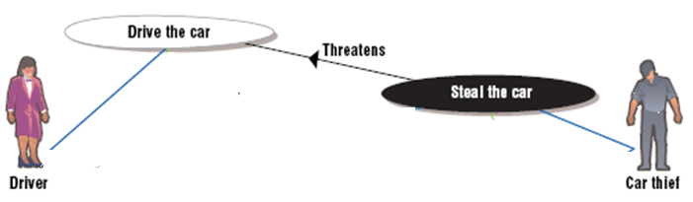
Attack Scenario
Attack scenarios are adverse use cases
“Actor” is a threat agent (aggressor).

Slide 7
Application Areas of Attack Scenarios
Define functional requirements Define nonfunctional requirements Attack analysis

Slide 8
Define functional requirements

Slide 9
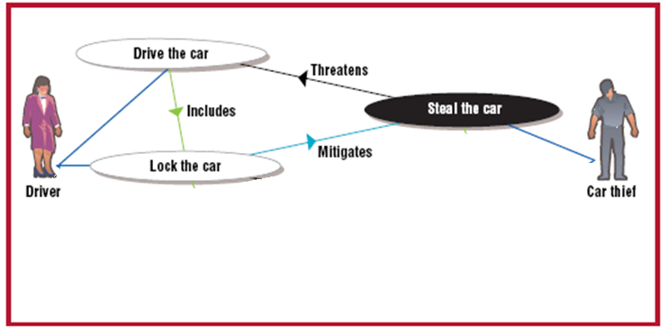
Define functional requirements

Slide 10
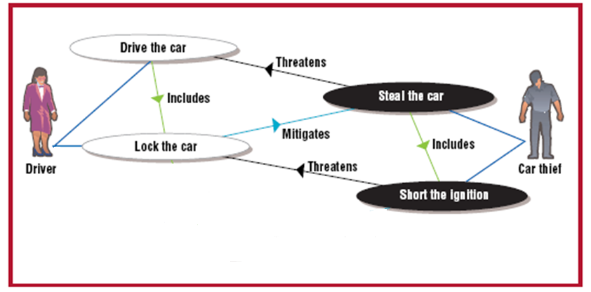
Define functional requirements
Notes:
Misuse cases can be developed recursively

Slide 11
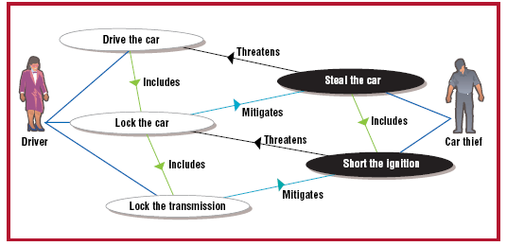
Define functional requirements
Notes:
Misuse cases can be developed recursively

Slide 12
Define non-functional requirements
“Araç STD-123-456 standardında belirtilen fiziksel saldırı dayanıklılığına uygun olacaktır”

Slide 13
Attack Scenario: Documentation
Threat agent (Attacker) Threatened assets Threat location (physical/virtual) Assumptions Capability of the threat agent Attacker resources Current measures Threat scenario steps Main flow Alternative flows Risk assessment Probability of threat (Attacker motivation, capabilities) Impact of threat (Asset value, impact of attack on entity)

Slide 14
Attack Scenario Example
Name: Get the user password Description: The attacker (Threat Agent) obtains and uses the user password by reading messages on a vulnerable network. Author, Date Threat Agent: Internal Threat Threatened Entities: User password, Network

Slide 15
Attack Scenario Example - 2
Assumptions
The attacker has access to the internal network. The attacker can see messages on the internal network. The attacker is able to record messages on the internal network.

Slide 16
Attack Scenario Example - 3
Main Stream (Successful flow for attacker and failed for system)
Installs offensive IP listening software (Sniffer). The threat agent receives and records all packets on the network. The attacker analyzes the packages it receives and saves. An attacker obtains explicit user name-password information. An attacker logs into the system with the user name-password information it obtains. The system allows the threat agent to enter with the obtained information.

Slide 17
Attack Scenario Example - 3
Alternative Flows Alternative ways to complete the scenario. Assume that the system has a (weak) encrypted password challenge-response protocol that allows replay attack.
A.1: Attacker obtains an encrypted password challenge (Step 1) A.2: Attacker replays the known encrypted password challenge (Step 2) A.3: System responds with encrypted password response (Step 4) A.4. Attacker replays the encrypted password response for the known encrypted password (Step 5)

Slide 18
Attack Scenario Example - 4
Final state
The attacker successfully logged into the system.

Slide 19
STRIDE Threat Classification
S: Spoofing
Deliberately announcing wrong identity information
T: Tampering
Changing the data itself or its flow
R: Repudiation
Denial of actions already done
I: Information Disclosure
Accessing information without authorization
D: Denial of Service
To prevent the normal operation of a system or service, or to degrade its performance
E: Elevation of Privilege
Using one priviledge to reach a higher priviledge.

Slide 20
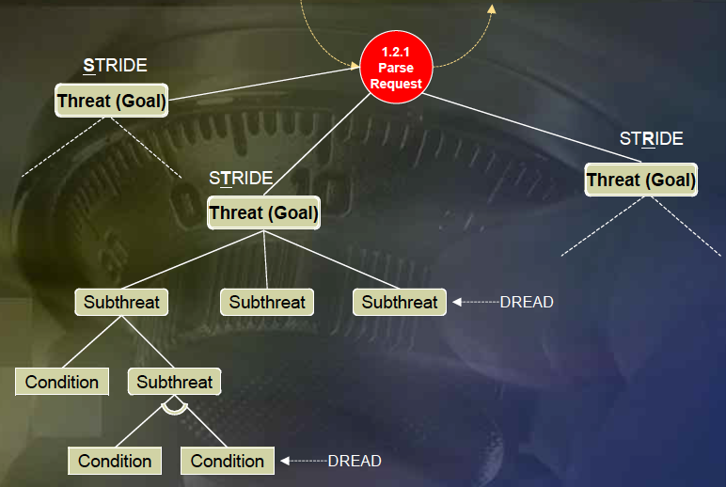
Modeling threats with STRIDE

Slide 21
STRIDE Classification of Threats to Assets
Threat Category Asset Type | S | T | R | I | D | E
External entity | √ |  | √
Process | √ | √ | √ | √ | √ | √
Data store |  | √ | √* | √ | √
Data flow |  | √ |  | √ | √

Slide 22
References
I. Alexander, "Misuse Cases: Use Cases with Hostile Intent," IEEE Software, vol. 20, no. 1, pp. 58-66, Jan/Feb, 2003.
Software Security: Building Security In, Gary McGraw, Addison-Wesley, 2006, ISBN: 0-321-35670-5
Security Software Development Assessing and Managing Security Risks, Douglas A. Ashbaugh, 2009, CRC Press (Chapter 3-4)
ENISA Threat Landscape 2015 – Europa https://www.enisa.europa.eu/publications/etl2015/at_download/fullReport
The Security Development Lifecycle – SDL: A Process for Developing Demonstrably More Secure Software, M. Howard, S. Lipner, 2006, Microsoft Press (Chapter 4)

